Slide 1

“Digital transformation is not about technology - it’s about change.”

Slide 2
“Digital transformation is not about technology - it’s about change.”

Slide 3
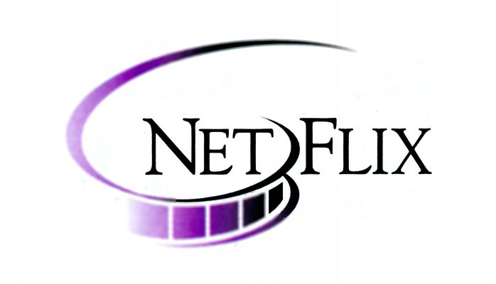
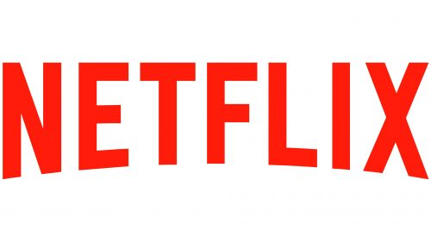
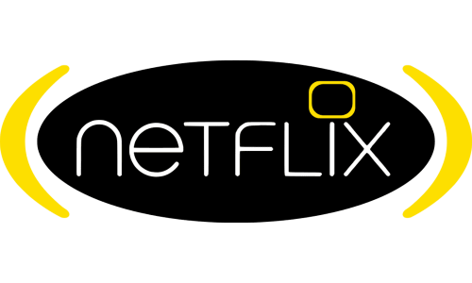
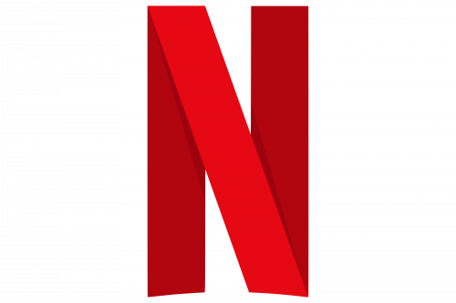
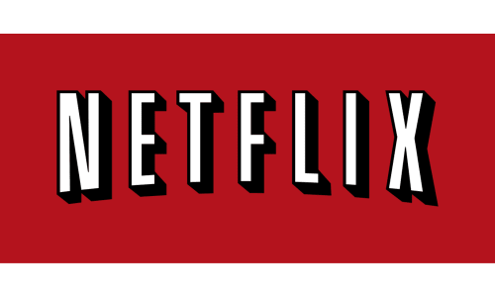



CHOOSE THE CORRECT LOGO!!!
THE FOURTH ONE!!
WHICH ONE IS THE RIGHT ONE?
ALL OF THE ABOVE
THE SECOND ONE!!

Slide 4
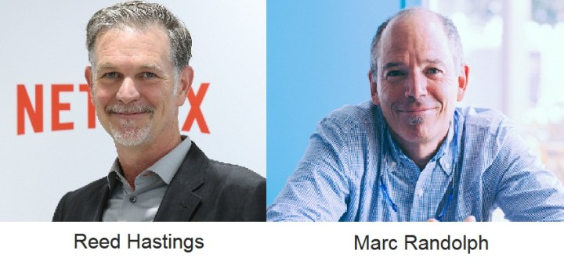
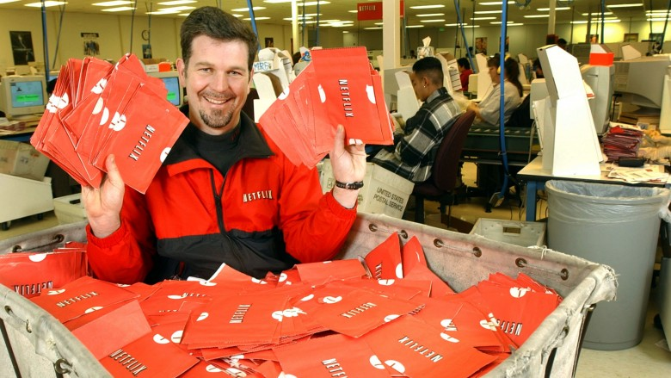
NETFLIX AND ITS HISTORY
WHAT IS NETFLIX? HOW DID IT ORIGINATE?
Founded in 1997, Netflix started out as a DVD rental-by-mail service.
Founders Reed Hastings and Marc Randolph.
Hastings was charged a late fee for a movie rental which led him to the idea of Netflix as a DVD RENTAL COMPANY.
In September 1999, Reed Hastings implemented a subscription-based business model.
Until the mid-2000s Netflix was unprofitable but, survived the dot com bubble. The company offered DVDs via US Postal Service, and had put up their catalogue online. Relying on US Postal Service’s delivery meant that Netflix could focus on their core offerings.
They offered a personalized suggestion catalogue service which they wanted to make their core.
USP - web-based catalogue of films.
Instead of having storefronts, the primary means by which customers could access the catalogue was online. This meant that every user in every part of the country could have access to the full library that Netflix possessed, rather than being limited to the titles the nearest stores carried. This also meant that users could shop around for the films they wanted to watch in the leisure of their homes.

Slide 5
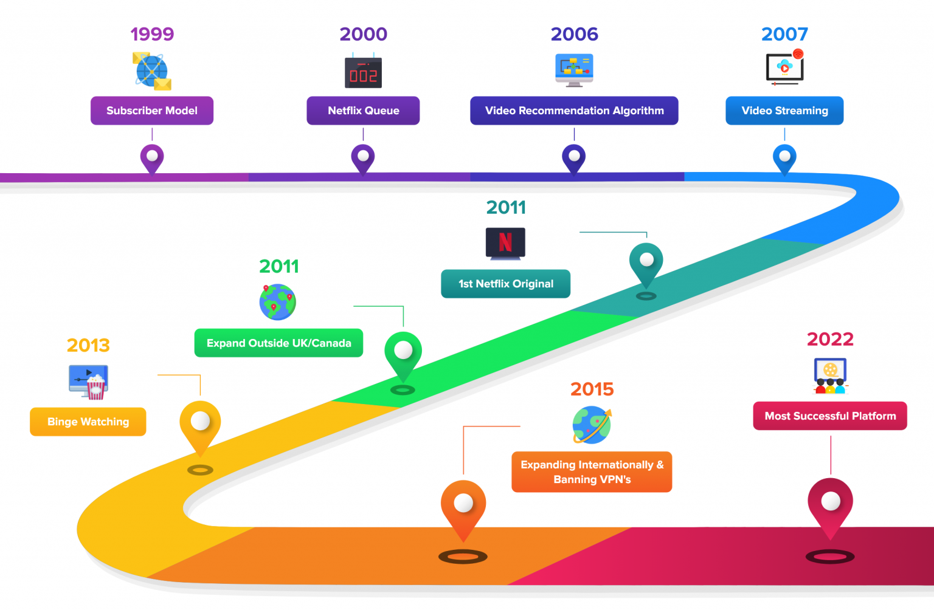
In August 2008 Netflix experienced a major database corruption, and could not ship out their DVDs for three days. This was the stimulus that led to Netflix opting to host their business logic on the cloud. This cloud migration would take place for the main part in the period of 2010-2011, and would only be completed in 2015, when the company finally setup its billing infrastructure, the most sensitive part of its business operation, on the cloud. The complete shift to the cloud was a pathbreaker in the tech industry. Throughout the history Netflix, it has built a highly robust cloud infrastructure, which has enabled the company to scale up seamlessly as it has seen exponential growth and as it has expanded to 190+ countries.

Slide 6
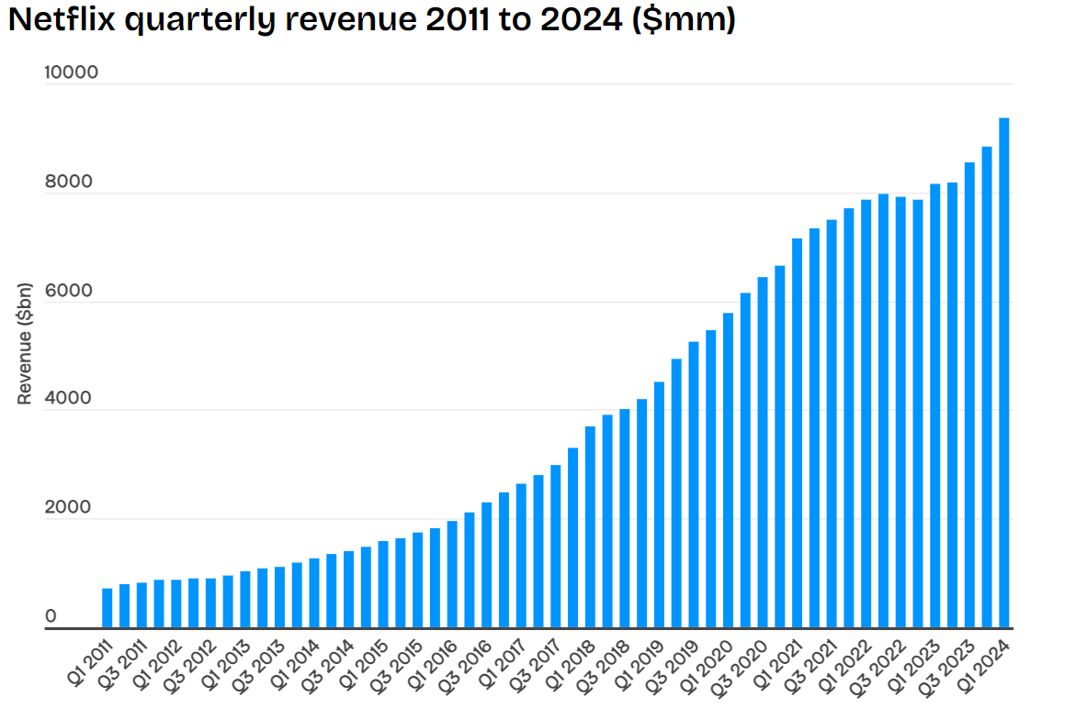
NETFLIX NOW
Netflix NOW is the world’s largest, most well-known streaming service, has a market capitalization of $252.71 Billion (as of 2024).
That is almost one-fifth of the size of Alphabet, which is Google’s parent company.
If all 260 million of Netflix’s paying subscribers would come together and make a country, it would be as large as Indonesia.
Netflix’s revenue for 2023 was $33.7 billion. For context, it is almost equal to General Motors market capitalization. Python is utilized across the whole Netflix content delivery lifecycle.
Technology :- Netflix uses the Python programming language to implement technologies such as video ingestion or distribution, security, machine learning, and artificial intelligence, which will ultimately aid in the creation of tailored recommendation systems.

Slide 7
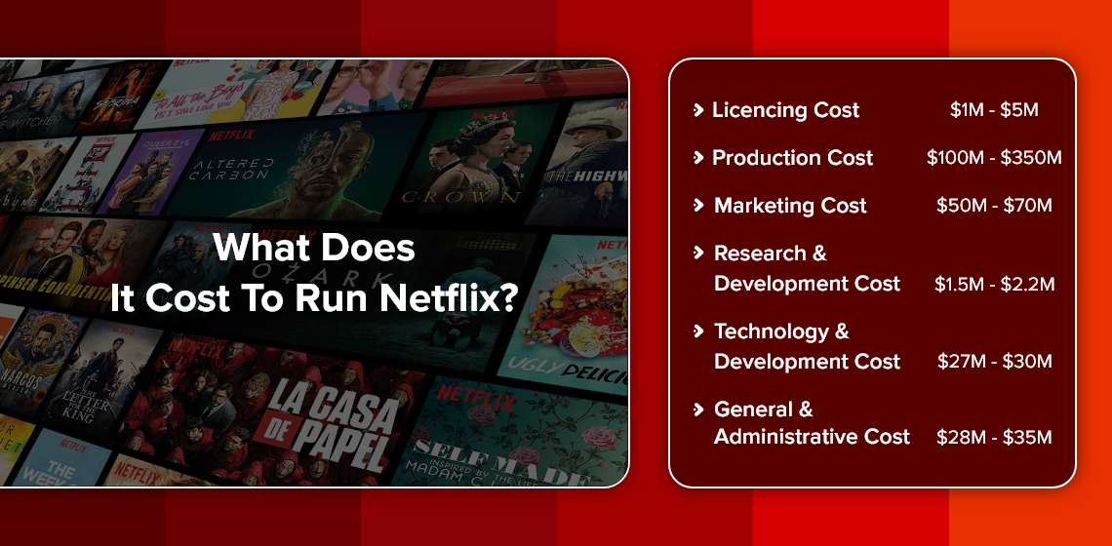
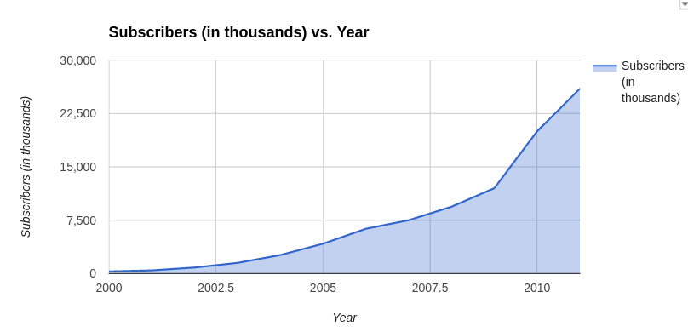
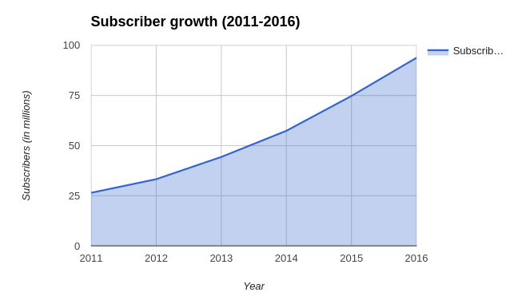
GROWTH JOURNEY and current cost it incurs

Slide 8
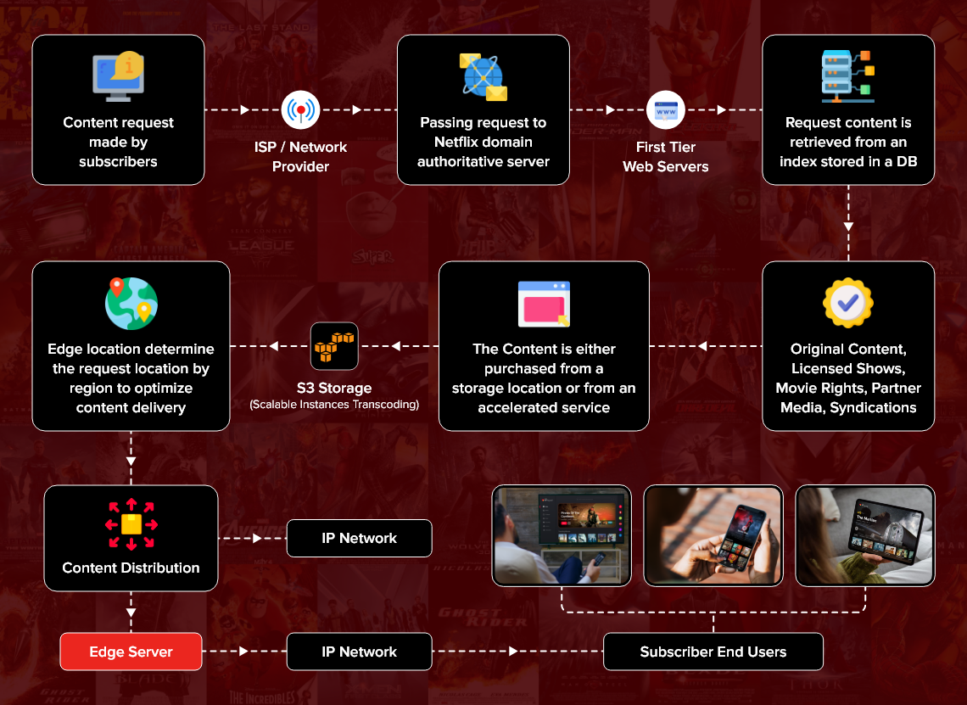
How Netflix Works?
Basic steps:-
Netflix works like a big digital library with movies and TV shows that you can access via the internet.
STEP 1:-
Install the app and sign up for a subscription.
STEP 2:-
Choose from a variety of subscription plans, including a basic plan that costs $8.99 per month, a standard plan for $13.99 per month, and a premium plan costing $17.99 per month.
Plans allow you to access Netflix on various devices and share it with various loved ones accordingly.
Technical way:-

Slide 9
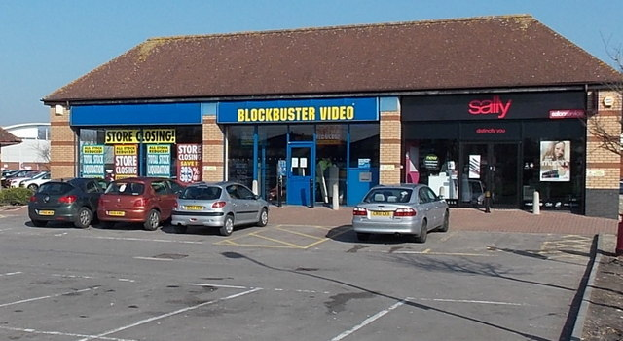
CHALLENGES FACED
BLOCKBUSTER REJECTION
Amidst Netflix's financial struggles ,Netflix was losing money terribly when it came to the rentals. CEO Reed Hastings met with Blockbuster's CEO (the biggest competitor back then), John Antioco, in Dallas. Hastings proposed selling a 49% stake in Netflix to Blockbuster for $50 million. He suggested Netflix could manage Blockbuster's online presence while complementing their offline DVD rentals. Antioco passed on the deal, doubting Netflix's value. Netflix's model, which eliminated late fees and mailed DVDs directly to customers, disrupted traditional video rental stores. Despite initial losses, Netflix's IPO on March 24, 2002, raised $82.5 million, showing improvement over previous years. Blockbuster's failure to adapt led to Netflix's eventual success.

Slide 10
Early Financial Difficulties: Netflix faced severe cash flow problems and struggled to make a profit when it first started. The CEO, Reed Hastings, had nightmares about whether the firm would survive. Doubt and Rejection: Potential partners and investors have expressed skepticism over Netflix's business plan. Hastings had several rejections, one of which stands out from the rest: Blockbuster turned down his proposal for a joint venture. Creative but Dangerous Model: At that moment, sending DVDs straight to clients was an advanced concept. It was costly, dangerous, and demanded a leap of faith from the business as well as its clients. Rivalry: Long-standing behemoths such as Blockbuster misjudged Netflix's potential and considered it as a little threat. It was always an uphill struggle to compete with firms that were so well established. Netflix removed late fees: the streaming service

Slide 11

TATA CONSULTANCY SERVICES (TCS)

Slide 12
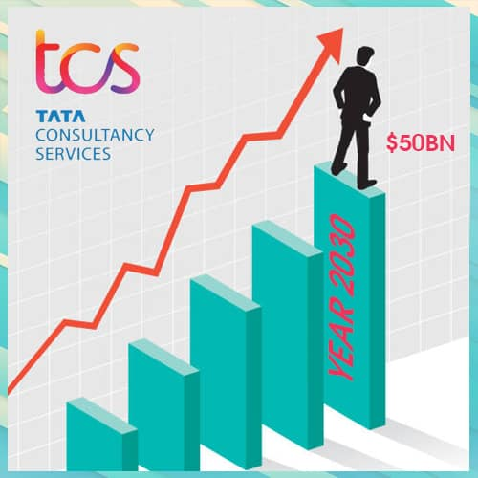
What technology is being used?
TCS has adopted a variety of technologies that include cloud computing, artificial intelligence (AI), and analytics for large amounts of data, to improve its service offerings and operational efficiency. These technologies enable TCS to provide unique solutions for clients across several industries.

Slide 13
Before and After Story.
Initially, TCS used traditional IT service models, which hindered scalability and responsiveness. The corporation realized the need of innovating and adapting to the digital era. After deploying digital technologies, TCS revolutionized its operations, allowing it to provide more flexible and scalable services. This transition has propelled TCS to the forefront of the global IT services industry, contributing considerably to revenue growth.

Slide 14
What strategies did they use?
TCS's approaches to digital transformation included: Investing in R&D: Devoting resources to the research and development of innovative technologies.
Client-Centric Approach: Emphasis on understanding the client's needs and developing solutions accordingly.
Agile Methodologies: Using agile principles to improve project delivery and responsiveness.

Slide 15
Challenges that they Encountered
TCS encountered obstacles such as:
Managing Change: The transition from old models to digital frameworks necessitated considerable cultural changes inside the company.
Skill Development: It was critical to train personnel to work with new tec-hnology on a continuous basis. Data Security Concerns: As digital activities grew in size, it became increasingly important to have strong cybersecurity safeguards.

Slide 16
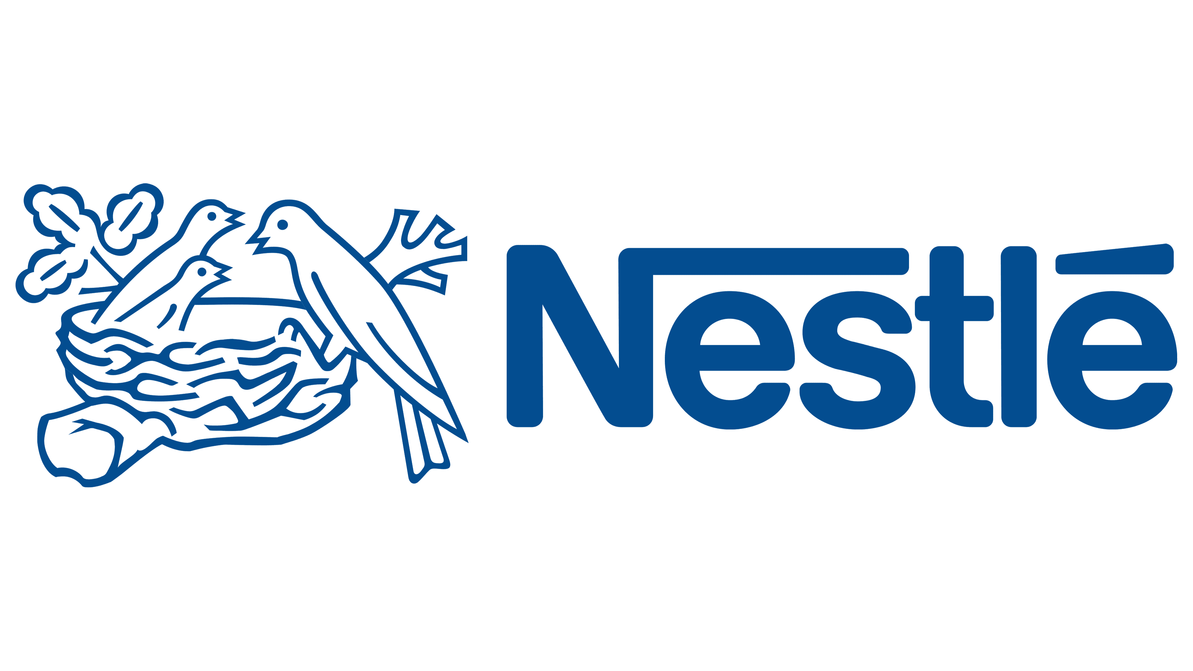

Slide 17
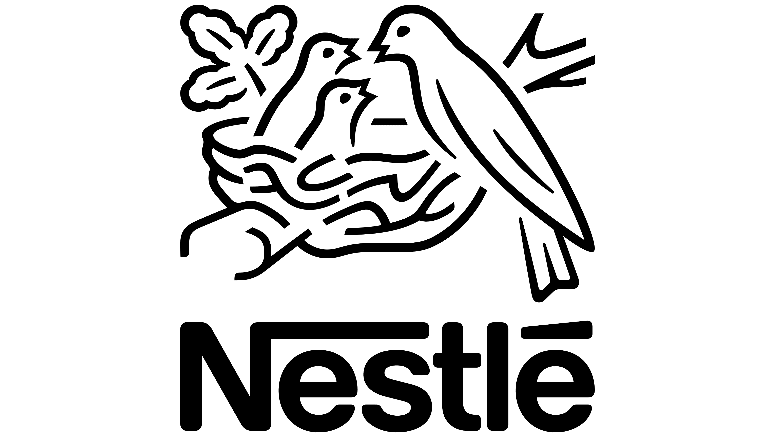

HISTORY OF NESTLÉ
Nestle first started in the year 1866.
Initially called "kindermehl," or "children flour," his product had an advantage over Liebig's "soup for infants" in that it was much easier to prepare, needing only to be boiled prior to feeding, and it soon proved to be a viable option for infants who were unable to breastfeed.
People quickly recognized the value of the new product, and soon Henri Nestlé's Milk Flour was being sold in much of Europe. By 1874, just seven years after the launch, 18 countries had their own distribution network and local Nestlé agents.

Slide 18


Slide 19
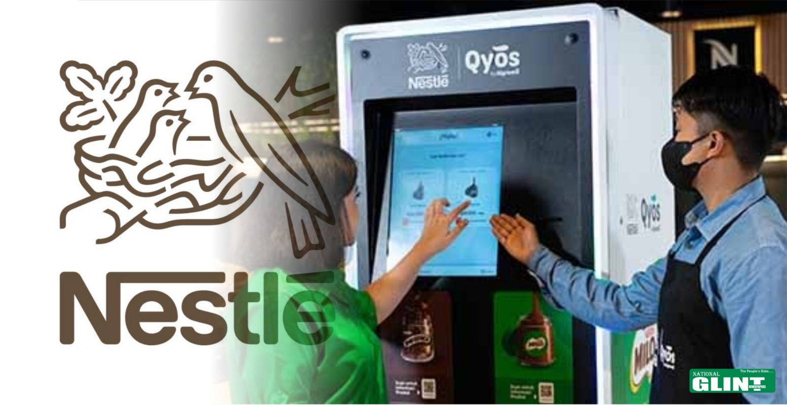
WHAT TECHNOLOGY IS USED??
Nestlé has embraced an extensive variety of cutting-edge technology, including big data analytics, artificial intelligence (AI), and digital marketing platforms. These techniques have helped them optimize their supply chain, increase consumer interaction, and stimulate creativity in product creation.

Slide 20
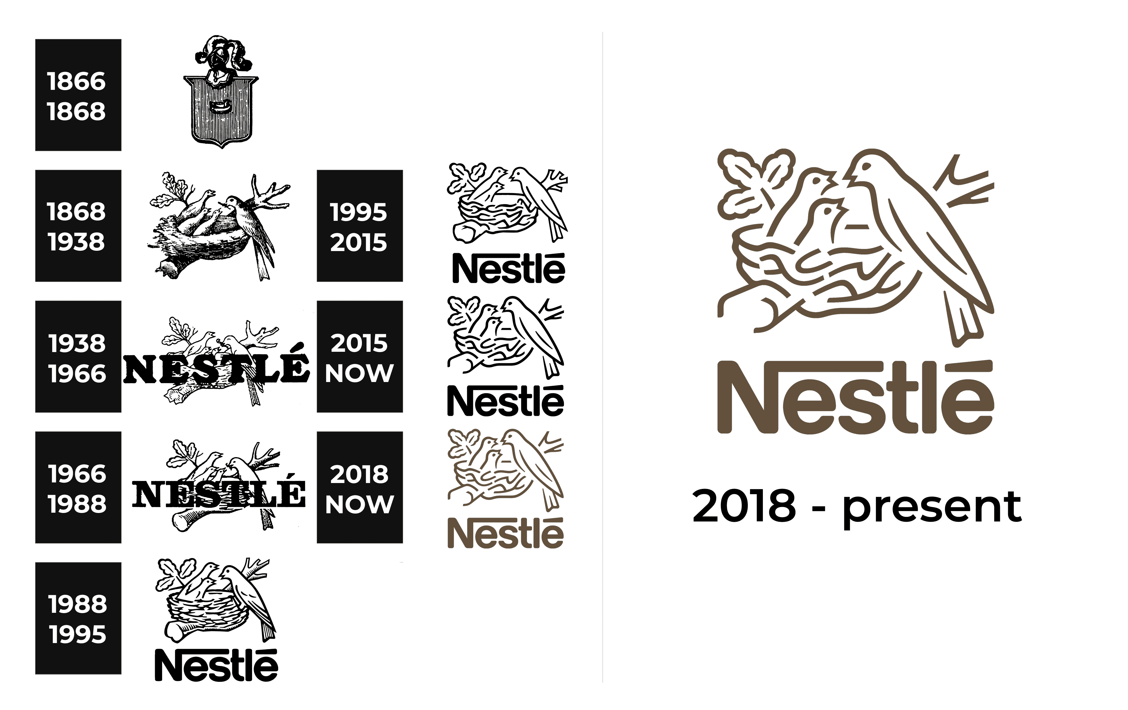
NESTLE THEN AND NOW
Historically, Nestlé relied significantly on traditional marketing and distribution methods. Their products, which included popular dairy brands such as Nido and Bear Brand, were mostly sold in physical stores, and marketing efforts were concentrated on traditional advertising. However, as consumer patterns shifted toward online buying and digital interactions, Nestlé understood the critical need to adapt. The transformation was significant. Nestlé increased its reach and boosted its online presence by investing in e-commerce platforms. Customers can now readily purchase Nestlé products online, and the firm communicates with them via social media and digital initiatives, resulting in a more participatory and personalized experience.

Slide 21
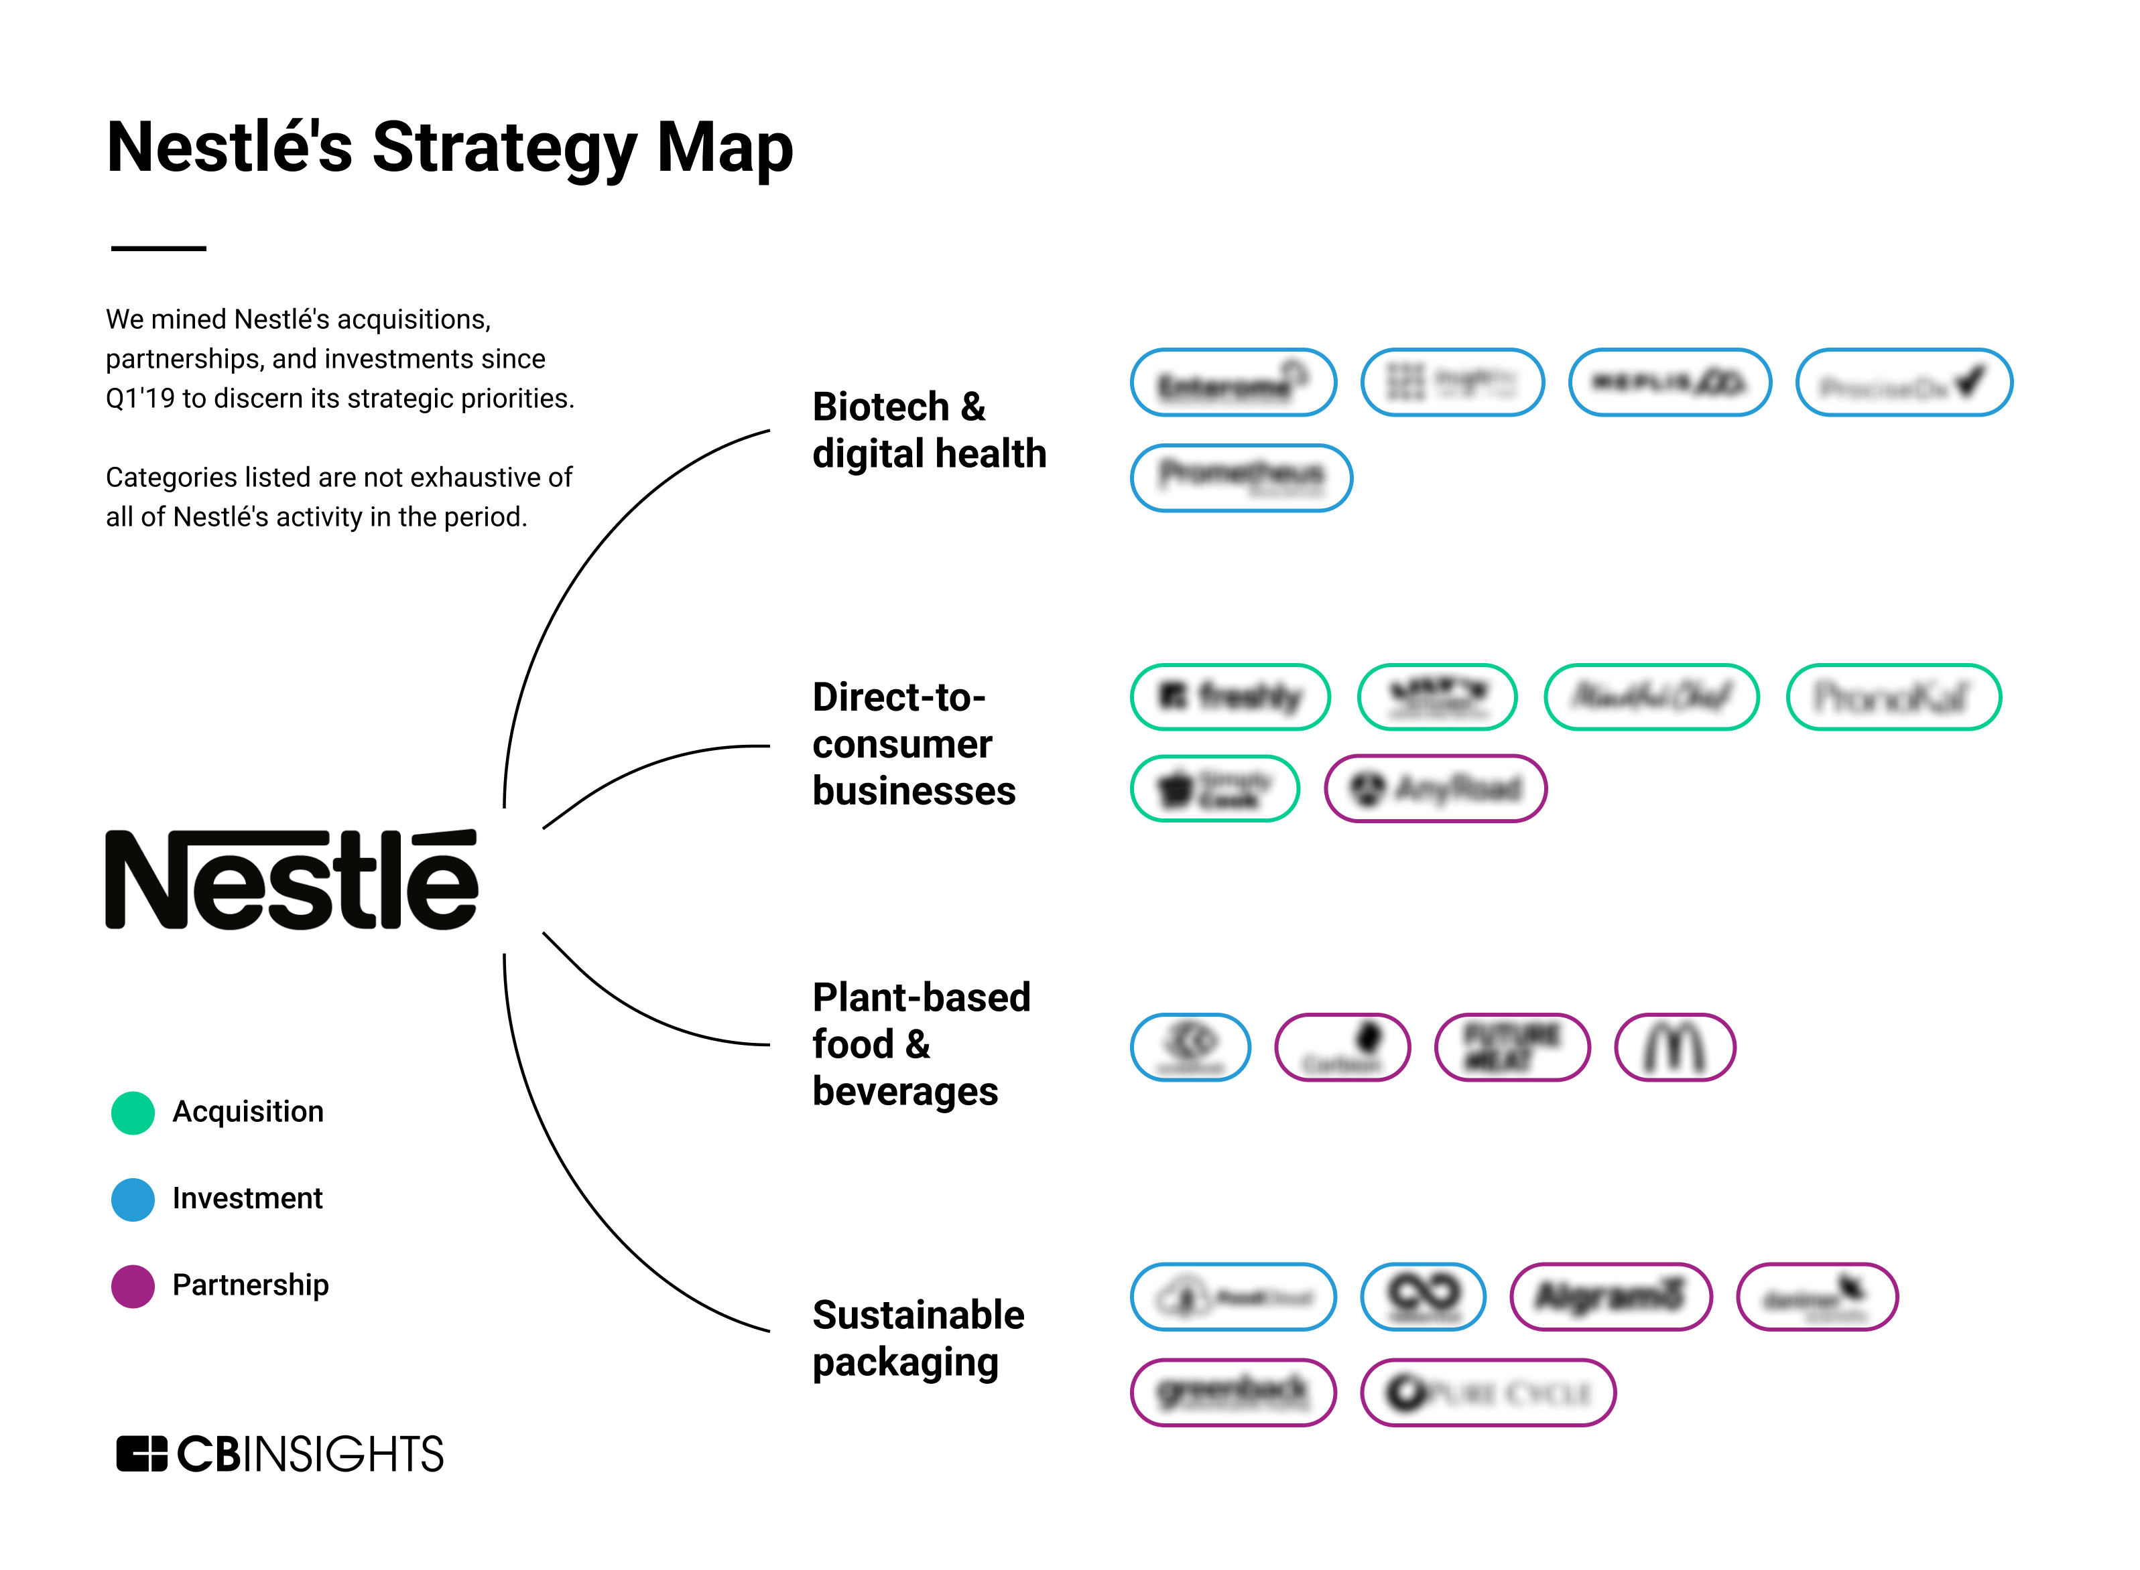
STRATERGIES USED
Nestlé's strategy to digital transformation consisted of four important strategies: E-commerce Expansion: They made significant investments in online sales channels to meet the growing demand for food shopping via the internet. Data-Driven Insights: Nestlé got important insights into customer habits by leveraging big data analytics, allowing them to better personalize their marketing efforts. Digital Marketing: The company used social media and digital advertising to directly communicate with customers, promoting its dairy products in a more relatable and impactful manner.

Slide 22
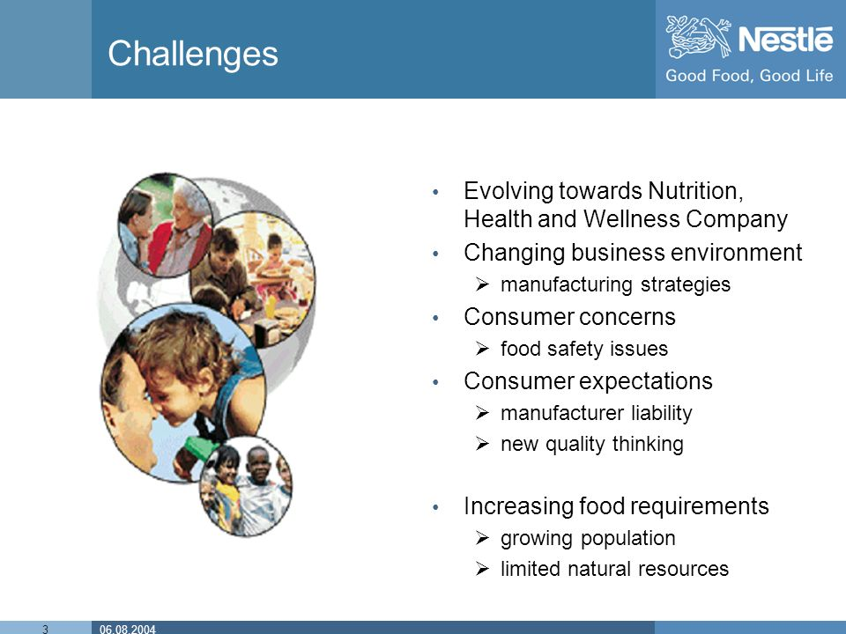
CHALLENGES FACED
Nestlé, like any big transition, faced its fair share of challenges: Cultural Shift: Inspiring employees and stakeholders to embrace a digital-first mindset necessitated a fundamental shift in thinking and approach. Technology Integration: Ensuring that new digital tools functioned seamlessly with existing processes was a challenging undertaking. Data Privacy Concerns: Navigating the complexities of data protection requirements while efficiently exploiting consumer data for insights presented new obstacles.

Slide 23
WHY ARE BUSINESS TRANSFORMING DIGITALLY
Several elements drive the shift to digital transformation: Improving the Customer Experience: Businesses seek to create seamless and personalized experiences that satisfy the changing expectations of consumers. Increasing Operational Efficiency: Streamlining procedures lowers costs and boosts productivity. Staying Relevant: In today's continuously changing industry, reacting to digital trends is critical for preserving a competitive advantage.
SAIGITA GOKLANI 021330024398 BILL GATES
TBBT

